Slide 1

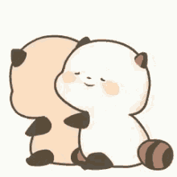
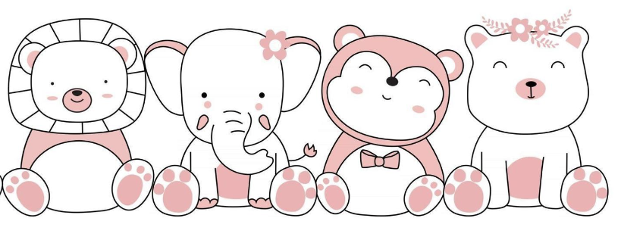

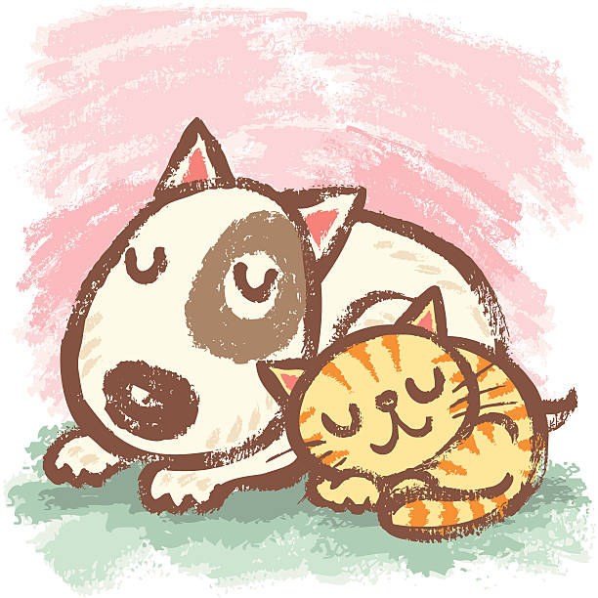
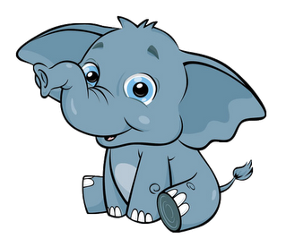
Cuddle Fests are a
non-sexual consensual touch
event
What is a
Cuddle Fest?
Rules
1. No one does anything they don’t want to
2. Wear comfortable clothes, they must stay on
3. Must be on time
Rated
G
Phases of a Cuddle Fest
Who Comes to a Cuddle Fest?
1
Welcome Circle
2
Consent Workshop
3
Cuddling
4 Closing Circle
To find out more go to
Cuddle New Mexico.com
People who want to
practice their boundaries
People that
want more touches
Can I give you a hug?
No
Consensual cuddling releases the hormone Oxytocin – which can reduce stress, lower blood pressure, even help to fight off sickness
Thanks for taking care of yourself
People that are curious
But what if …
Q: I’m pressured to …
A: You never have to do anything you don’t
really want to. That’s why we practice saying “no”.
Q: I don’t like it…
A: Everyone is free to leave at any time.
Q: I feel alone…
A: This is a great place to meet people,
but if it makes you feel more comfortable
it’s always great to bring a friend.
Q: I need support …
A: That’s why the events are facilitated.
Ask for help anytime.
It’s perfectly ok to just come and observe

Slide 2




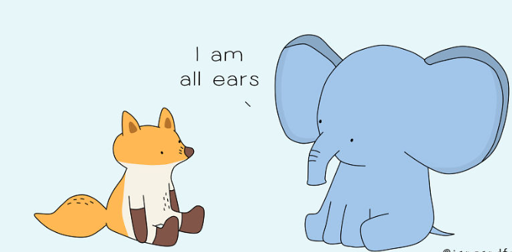
People who like structured socializing
Cuddle Parties are highly facilitated with a focus on creating a safe space.
To find out more, google:
New Mexico Cuddle Party
People that
don’t like small talk

Slide 3
Next Event:
Sat June 3rd
Los Alamos

Slide 4
Next Event:
Sat June 3rd
Los Alamos

